Slide 1
Exology
AI Financial Strategist for SMEs
Prepared by Hail Mary
Ahmed Shehab Mina Magdy
One message. Full financial intelligence.
TELEGRAM
N8N
GEMINI 2.5 FLASH
GOOGLE SHEETS
POWER BI

Slide 2
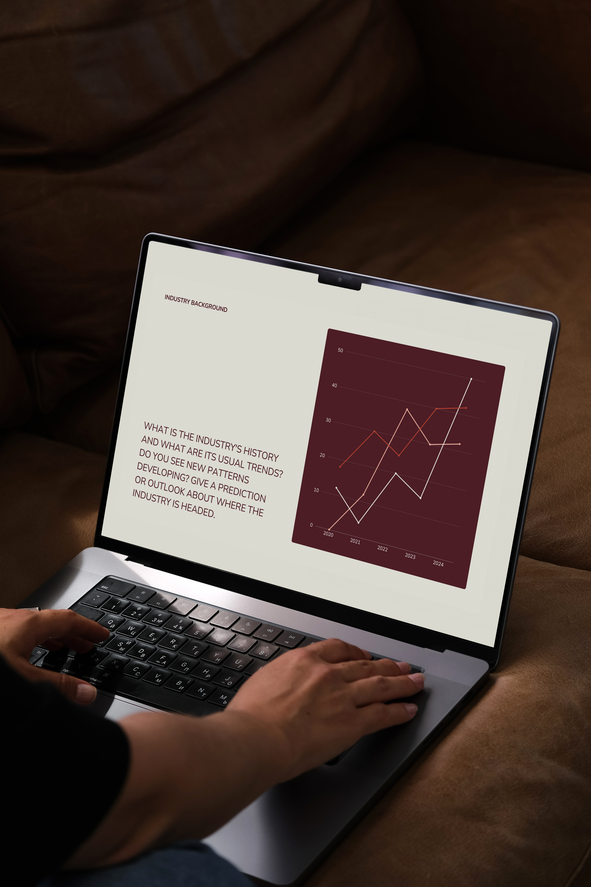
THE PROBLEM
Small Business Owners Suffer From Financial Blindness
01 · Friction in Recording
02 · Reactive Management
Complex ERPs and spreadsheets lead to skipped entries and lost receipts. Recording feels like a second job.
Owners only discover they're running low on cash after it happens, with no time to adjust.
03 · Data Literacy Gap
Raw numbers in spreadsheets can't translate into strategic decisions. Data sits idle, unused.

Slide 3




THE SOLUTION
One System. Three Layers of Financial Intelligence.
01 · Smart Recording
02 · Predictive Forecasting
Send a text, voice note, or receipt photo. Gemini AI extracts 11 structured financial fields automatically — in Arabic or English.
Using 90 days of history, the system projects your cash balance 30 days ahead and alerts you before a cash drought hits.
03 · AI Health Score
Every Sunday, Gemini delivers a Health Score (Healthy / Warning / Critical) plus 3 specific action items.

Slide 4
GREEN AI
Built to Minimize AI Waste. By Design.
01 · Selective AI Usage
02 · Efficient Routing
Gemini is invoked only when true intelligence is required, extraction, OCR, transcription, and weekly analysis. Routing, scheduling, and validation run on n8n at zero AI cost.
The Switch node routes text, voice, and photo messages using boolean logic, no LLM call needed. A full AI Agent would burn 2-3 extra calls just to make this decision.
03 · Structured Output Prompting
Every Gemini prompt requests JSON directly, no paragraphs, no markdown. Result: ~327 tokens per transaction vs ~1,500 with a full AI Agent. An 80% reduction in compute waste.

Slide 5
ARCHITECTURE
Telegram Bot
Five Layers: Each Playing a Distinct Role
1
4. DATABASE
5. ANALYTICS
3. INTELLIGENCE
2. ORCHESTRATION
1. INPUT
2
n8n Cloud
Gemini 2.5 Flash
3
Accepts text, voice notes & receipt photos from the business owner
Routes messages, triggers AI models, manages all workflow logic
Real-time executive dashboard; live cash, forecasts, anomaly flags
Central cloud storage: Transactions, COA, Forecasts, Health Scores
Extracts JSON data, transcribes audio, performs OCR, generates insights
Google Sheets
4
Power BI Dashboard
5

Slide 6
How It Works
TELEGRAM INPUT
TELEGRAM REPLY
دفعت 750 جنية من الكارت
✅ Transaction Recorded
💰 Amount: 750 EGP
📊 Type: Expense
📂 Category: Internet
💳 Payment: Card
🏪 Vendor: Telecom Co.
🎯 Confidence: 97%
🆔 TXN-1715689200000
🎙 Voice note — 0:04
⟶
AI
Processing
📷 Receipt photo

Slide 7

ANALYTICS
Power BI Dashboard Boardroom-Ready Analytics
Live Cash Position
Card + Gauge showing real-time income vs. expenses vs. net cash balance.
Forecast vs. Actuals
Line chart comparing projected 30-day balance against real transactions.
Expenses by Category
Donut chart breaking down spending so owners see exactly where money goes.
Anomaly Flags
Table with conditional formatting highlighting unusual or high-expense rows.

Slide 8
COMPETITIVE EDGE
Why Exology Wins
Boardroom Dashboard
Frictionless UX
Tells You What to Do
While others show tables, Exology delivers a Power BI dashboard ready for a C-suite presentation.
3-second voice note = full financial record. No forms, no dashboards to navigate, no training needed.
Doesn't just store data — the AI CFO analyzes spending and gives 3 specific weekly recommendations.
Bilingual AI
Predictive Power
Gemini processes Arabic and English equally — built for the Egyptian SME market from day one.
30-day cash forecasting demonstrates technical maturity and deep understanding of real business needs.

Slide 9

Most businesses fail not because they don't make money — but because they lose track of it.
Exology turns a Telegram message into a 30-day financial roadmap.
3
Input Types
Text · Voice · Photo
11
Data Fields
Per transaction
30
Day Forecast
Cash projection
100%
Free Stack
Gemini · n8n · Sheets

Slide 10
Thankyou

